Slide 1
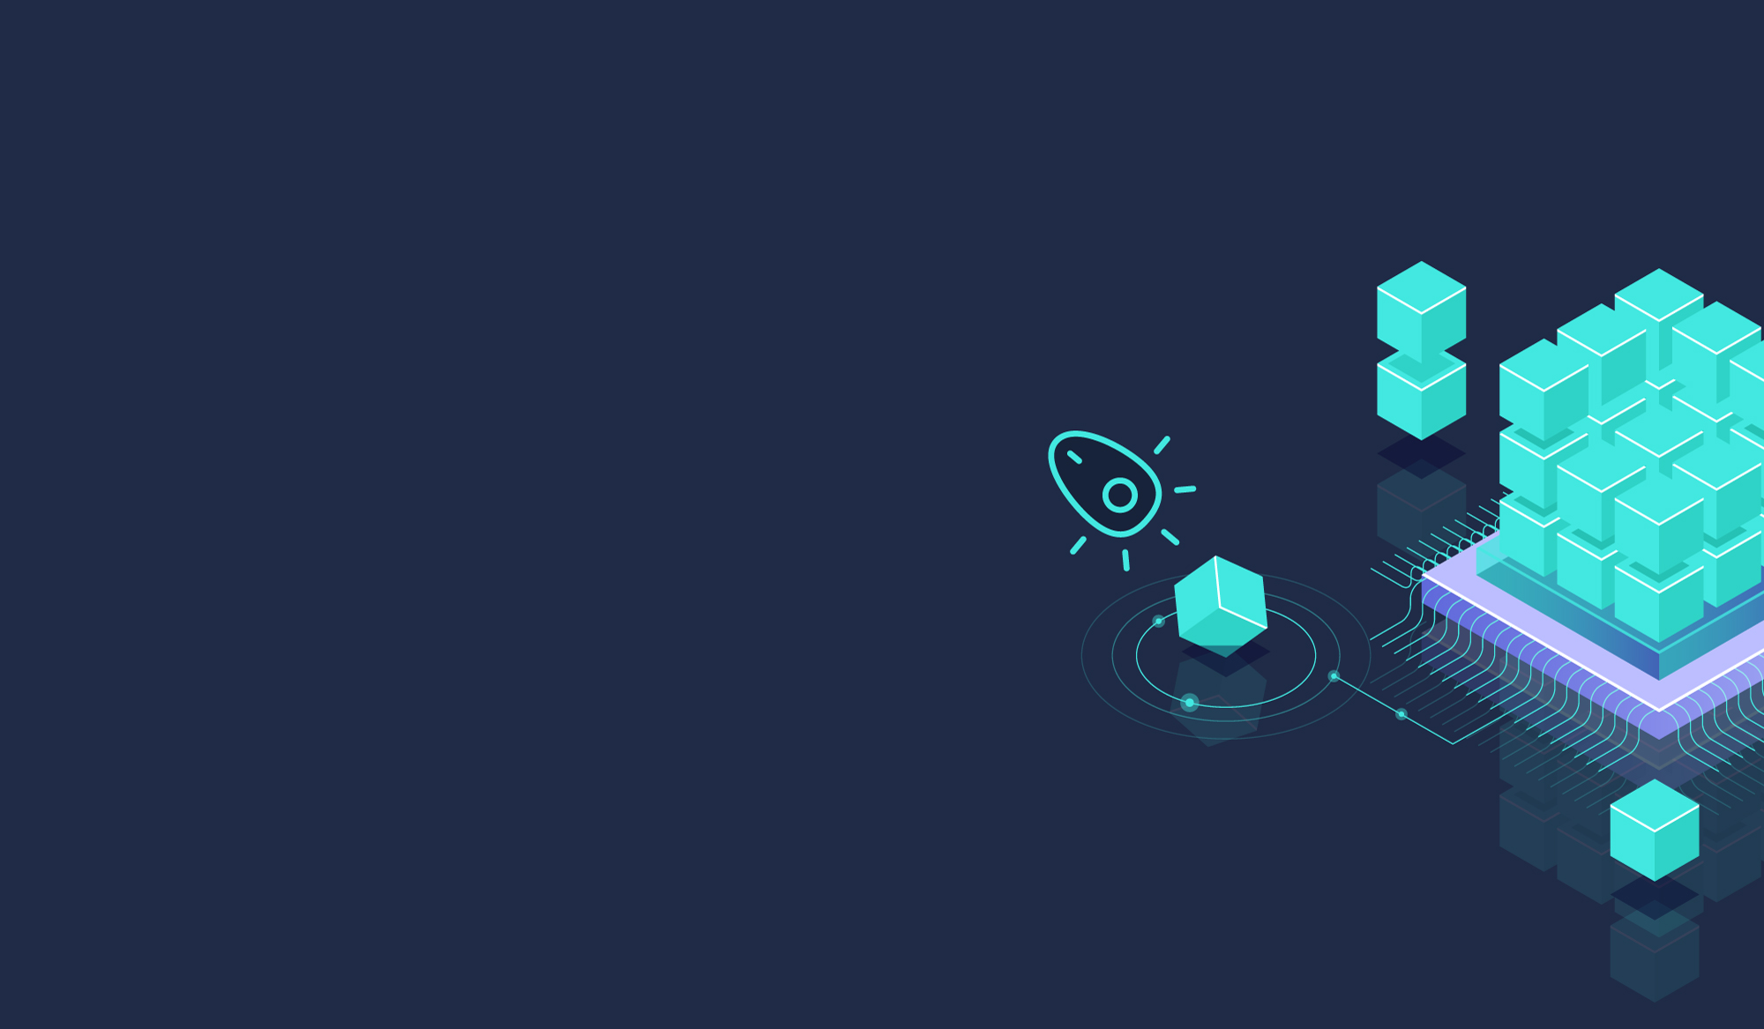

Data Management Walkthrough
How to set up a project

Slide 2
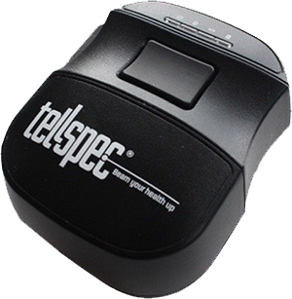
Data Management
With the Data Management web software, you’ll be able to create and personalise your own projects and to collect your data in a much simplified way.
Everything happens in a ​project​. A project has a name and information about the data to be collected, and about who is allowed to work on it.
With the Advanced Reports mode, you will be able to collect machine-learning training data and export sample data along with the spectra in absorbance units for use with whatever software you like (Reports). All the data is backed up to the cloud.

Slide 3
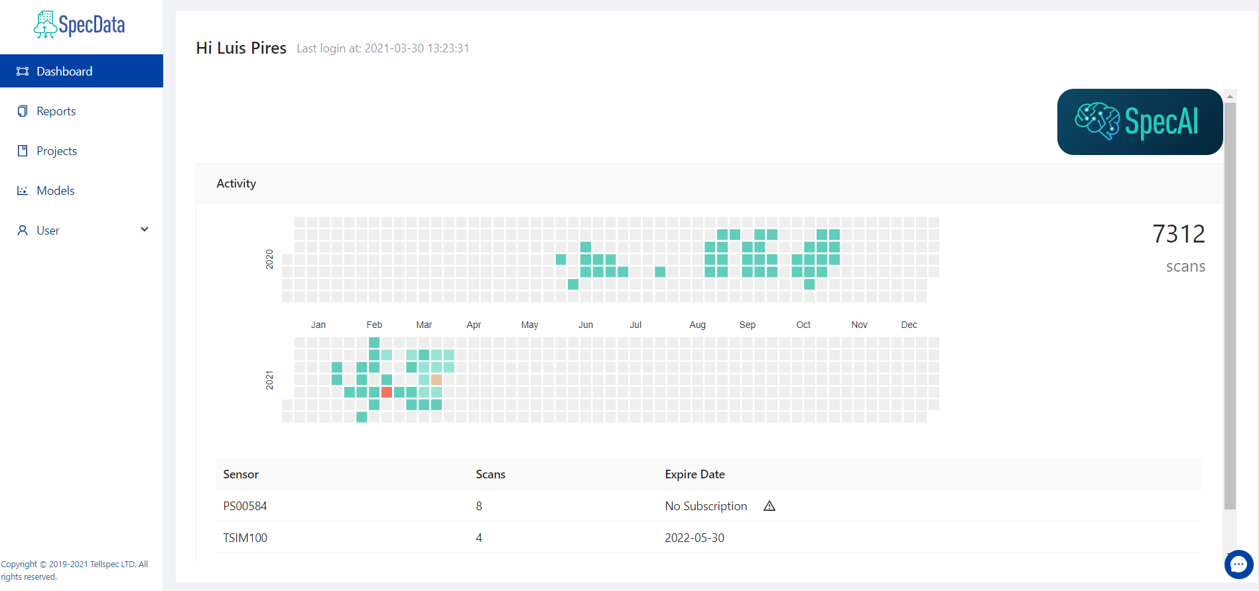
Introduction
In order to set up a new project, you have to go to our “Data Management” web based software.
This is your homepage. Its where you can see your activity and the sensors associated with your account.

Slide 4
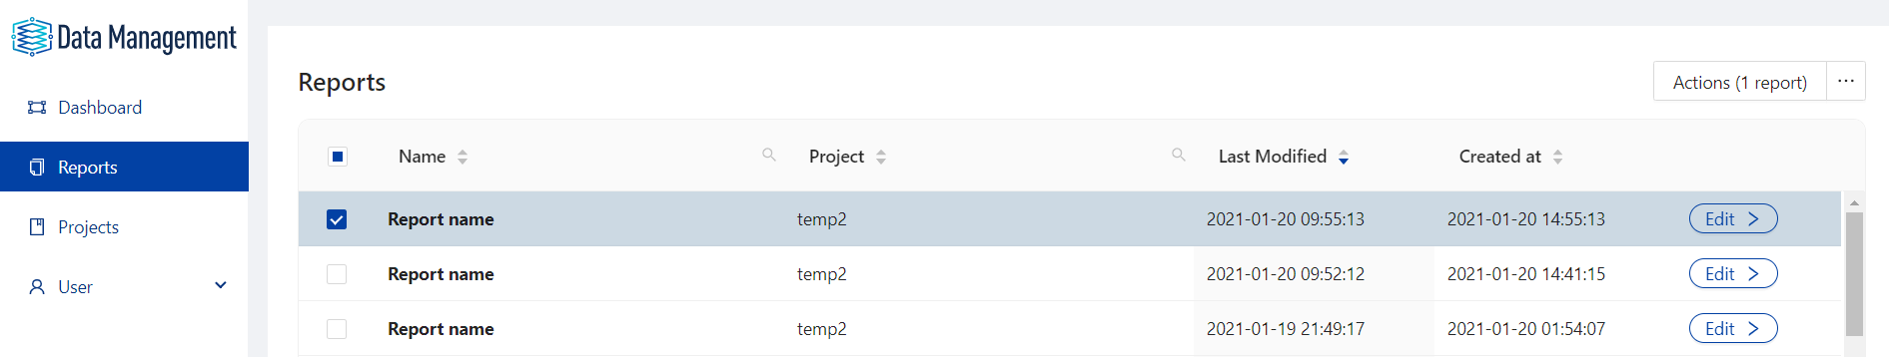
Reports’ page
Here you can view all reports associated with your account. You can also sort by report name, by project name, by date of creation and by date of the last modification.
By selecting “Actions” you can select one of the entries,
export data, send to the models framework (if you are using Tellspec’s AI Workshop), visualize the data or delete the entry.

Slide 5
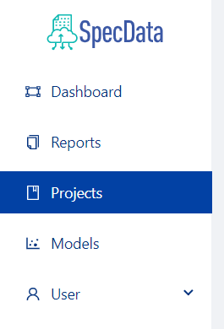

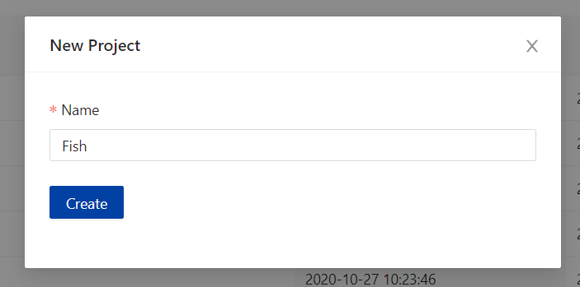
How to create a new project?
Let’s start our new project!
Access “Projects” on the left side of your screen.
Click the “+” button
Insert the name for your project

Slide 6
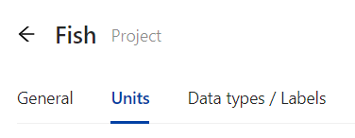
How to create a new project?
Click the button “Edit”, that is in the line of your new project.
In this page, you are able to update the project's name, add and edit the users associated with this project, change the colour of the project (you will see the colour in your mobile app) and add an image, if you want.
After this, move to the second tab “Units”, to create the units to use in your project.

Slide 7
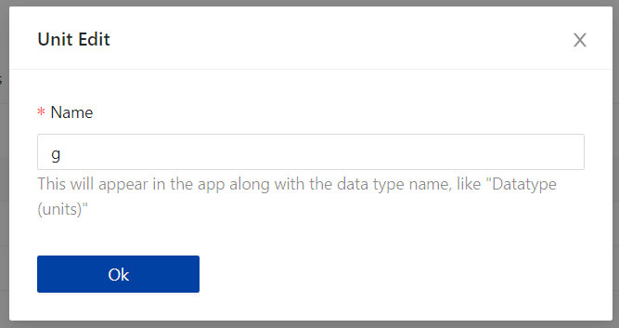
How to create a new project?
Click the “+” button, and new window will appear to enter the unit to be used.
Only write the short name of the unity that you want. For example, if you are using grams, write “g”.

Slide 8
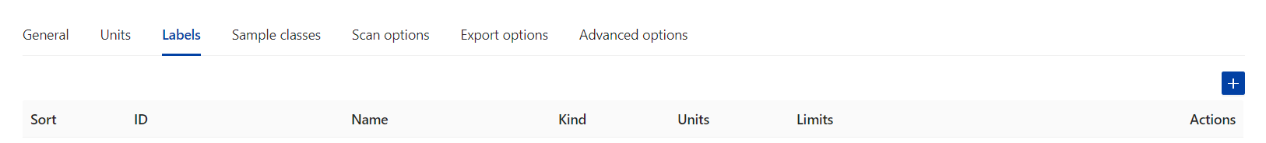
How to create a new project?
How to create a new project?
You are free to edit or delete the units that you added.
Here you can edit or delete the unit.
After the units’ creation, move to the next tab “Labels”. Here you can adding the parameters that you are collecting from your samples.

Slide 9
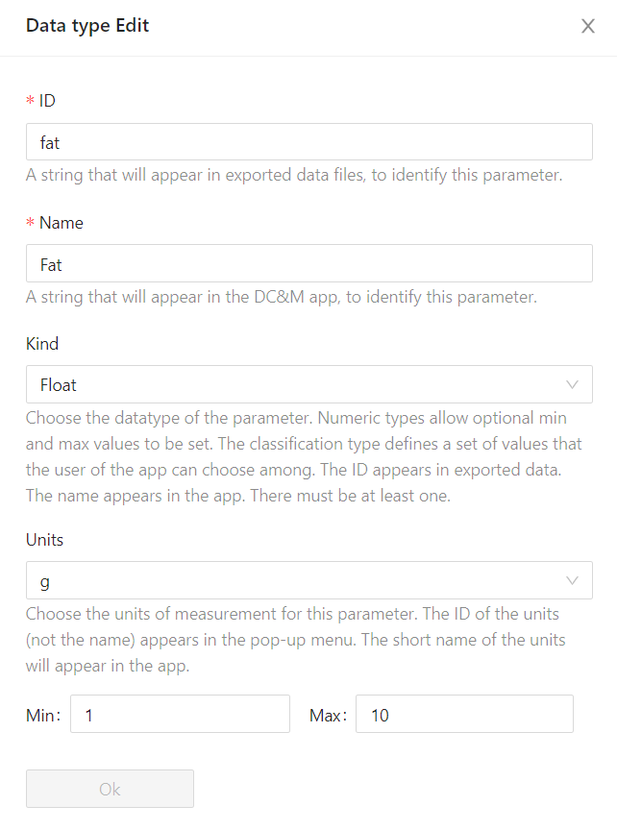
How to create a new project?
To add a new Data Type, please click the “+” button.
A new window will open. Enter the ID (use underscore instead of “space” and don’t use uppercase letters), enter the name, select the kind of data that’s going to be collected, select the units that you created previously and select a range for you collected data. If the measured values are lower or higher than the range that you selected, a warning will appear.
For each datatype, you can select the “Kind”. “Float” is a number with decimal point, “Classification” allows the user to select among, eg 'high', 'medium', 'low’. “Integer” stands for integer numbers and “text” allows the user to type anything.

Slide 10
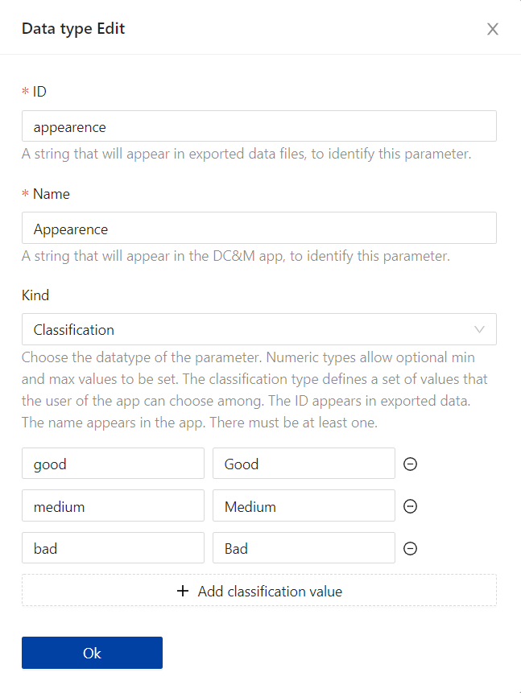
How to create a new project?
By selecting the kind “Classification”, a slightly different window will appear. In this new feature, you are able to insert the classification that you want to select. For example, we can use a visual classification of “Good”, “Medium” or “Bad”.

Slide 11
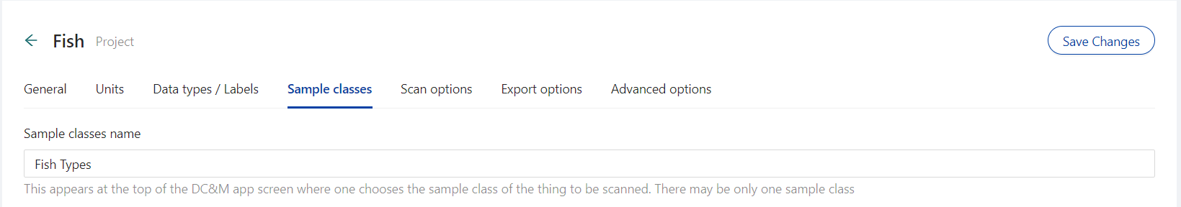
How to create a new project?
How to create a new project?
Then, its time to add our sample classes! For this, click “SAMPLE CLASSES” on the top bar. This is used so you can group the different groups of samples that you are collecting data from. In this example, we are going to insert different fish types..

Slide 12
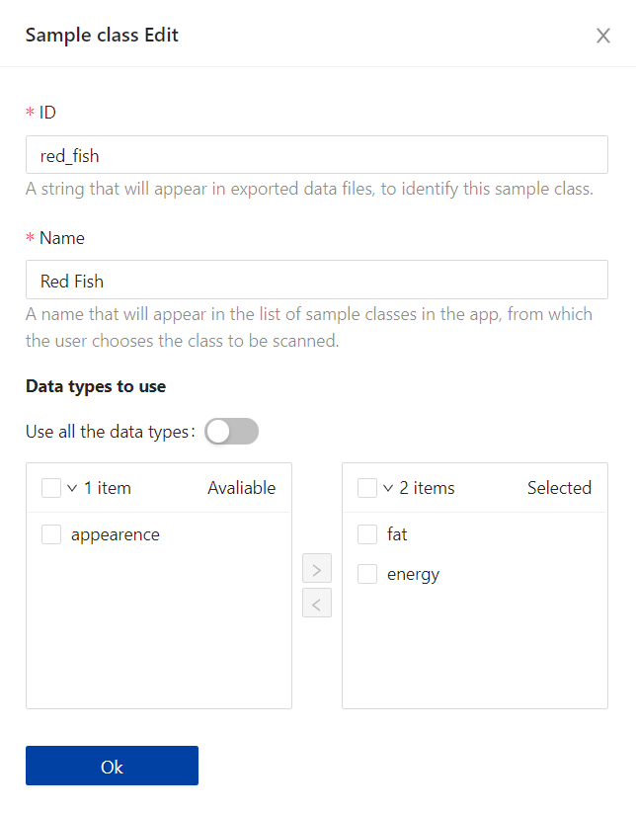
How to create a new project?
How to create a new project?
To add new samples, click “+”. A new window will appear and will allow the user to insert the ID, name and the parameters to collect.
When you add a new sample class, you are adding different types of samples under the project that you are running. For example, different brands.
The sample class names appears in the app when choosing what kind of thing is to be scanned. Some users have just one. In this case when the user of the app is about to scan something, they add a sample to their scanning session, and get a screen headed "Nutrients p/ Brand", with a list under it showing "Brand 1" and "Brand 2".
This is optional, except for the sample class name, which could be set to just "Sample". You must also have at least one sample class, which again could just be Sample (with ID sample).

Slide 13
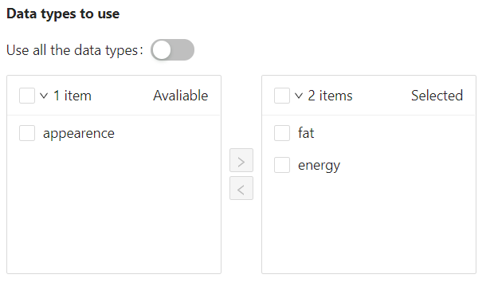
How to create a new project?
How to create a new project?
If you desire, you can even specify which one of the parameters you want to measure for each sample. The items on the left wont appear in your sample, and the ones on the right will. This feature is useful when you don’t need all data types for the one of the samples

Slide 14
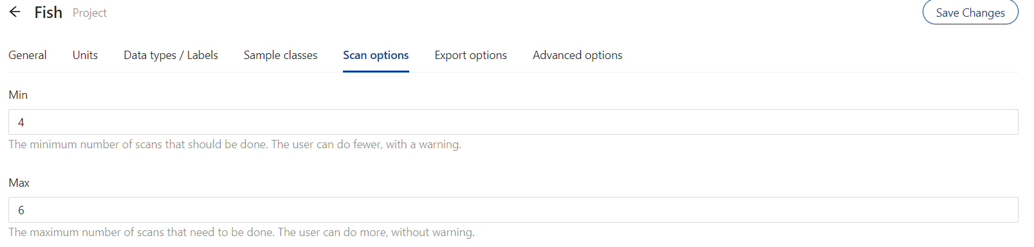
How to create a new project?
How to create a new project?
After the sample classes’ creation, you can go to the next tab to insert a minimum and a maximum number for each sample scan. Its useful when you are scanning larger samples, like a big fish.

Slide 15
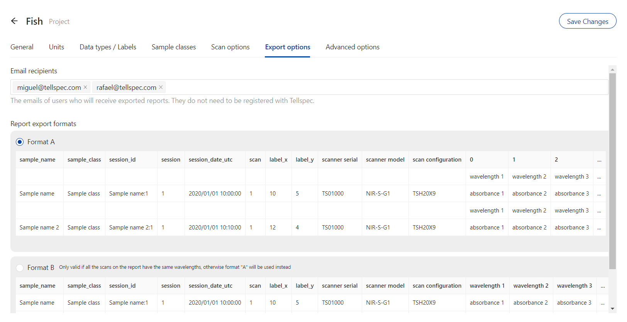
How to create a new project?
How to create a new project?
Moving to the next tab, here you can select the users that will receive the exported report, by tipping in their emails, and you are also allowed to select the format of the report.

Slide 16
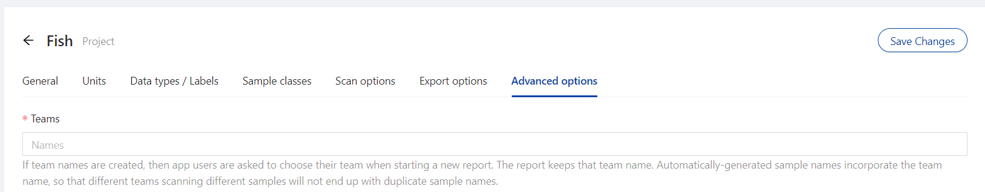
How to create a new project?
How to create a new project?
In the last tab, you are allowed to select the team allocated to the project, by tipping in their name.
Then, just click “Save Changes”, to save your new report. The report will be instantly available in your app.

Slide 17
Thank you.
If you are facing an issue or have a question, feel free to contact us at info@tellspec.com.

